Slide 1
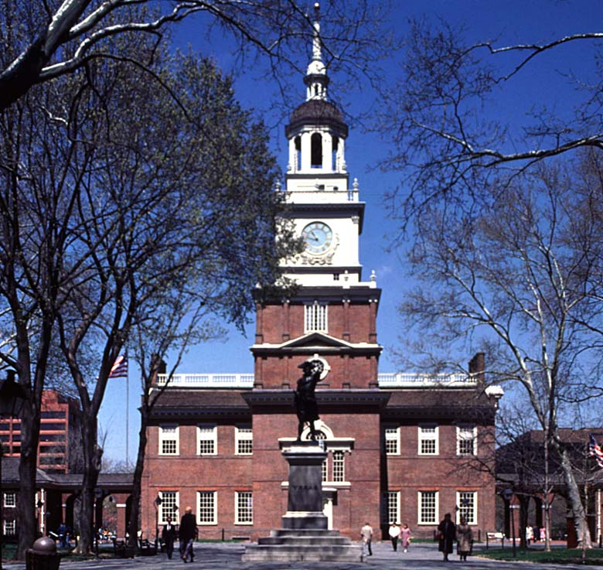
ORIGINS OF AMERICAN GOVERNMENT
AND THE CONSTITUTION

Slide 2
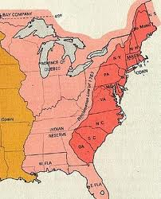
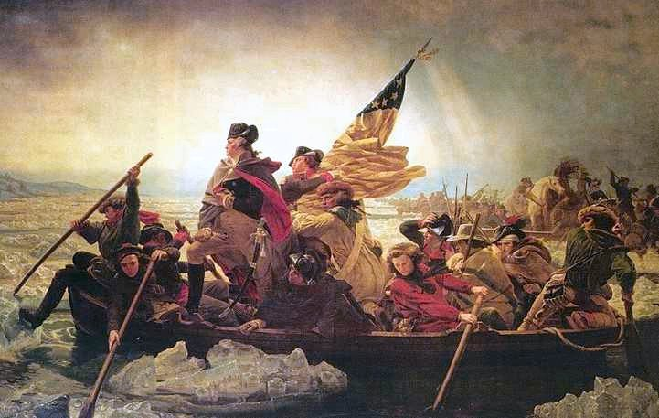
The Colonial Mind
A. Belief that British politicians were corrupt.
B. Belief in higher law of natural rights: life, liberty, property
C. The American Revolution was a “war on ideology”
D. Specific complaints against George III are outlined in the Declaration of Independence

Slide 3
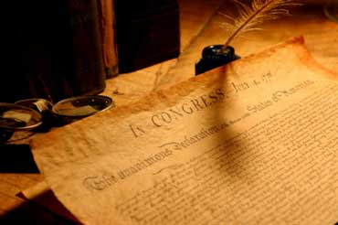
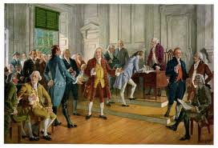
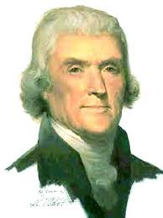
The Declaration of Independence was written by Thomas Jefferson during the Second Continental Congress in 1776. It lists specific grievances against King George III.

Slide 4
The Articles of Confederation was the first attempt at a national government.
Structure and Powers of the Articles of Confederation
Weaknesses of the Articles of Confederation
Unicameral legislature
Power to make war
Send and receive ambassadors
Make treaties
Borrow money
Set up monetary system
Build army, navy
Settle disputes
Small army, dependent on state militias
No taxes to pay for government
No control of interstate trade
No Federal supremacy
No national judicial system
No control of currency
State could tax imports and exprorts.

Slide 5
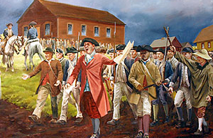
Shay’s Rebellion in 1786 led to the Constitutional Convention.

Slide 6
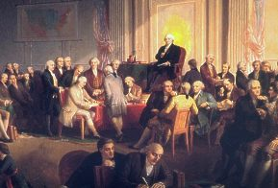
The Constitutional Convention was held in Philadelphia in 1787. 55 delegates attended.

Slide 7
The Virginia Plan
The New Jersey Plan
Called for a strong national government
Bicameral legislature
3 separate branches
Wanted representation based on population
Wanted to amend the Articles of Confederation
Wanted one representative per state
Protected the interests of the small states

Slide 8
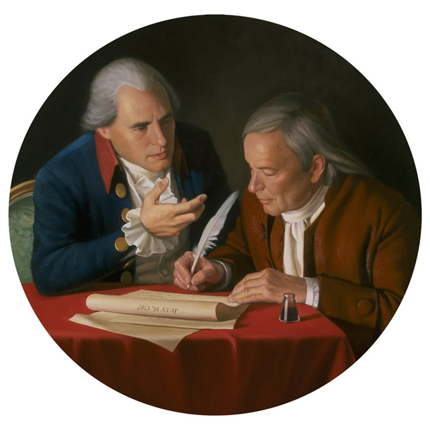
The Great Compromise
Compromise proposed by Connecticut included the House of Representatives based on population and the Senate is two per state.
This established the spirit of compromise, central to effective democracy.
Other compromises in the Constitution…
Three-fifths Compromise
Commerce and Slave Trade Compromise

Slide 9
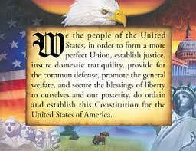

Slide 10
Significant political values of the Constitution
Republicanism – a form of government in which power resides in the people and is exercised by elected representatives.
Federalism – division of power between a central or national government and several regional governments.
Separation of Powers – legislative, executive and judicial powers are divided among three independent and coequal branches of government.
Checks and Balances – a major principle of the American government system whereby each branch of the government exercises a check on the actions of the others
Limited Government – a form of government based on the principle that the powers of government should be clearly limited and each individual has rights the government cannot take away.

Slide 11
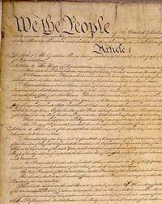
Strengths of the Constitution
Provided for an army
Power to tax
A Supreme Court – judicial review – established by Marbury v. Madison
Coin and regulate currency
No export taxes
Control of interstate trade
Federal supremacy – unity without uniformity

Slide 12
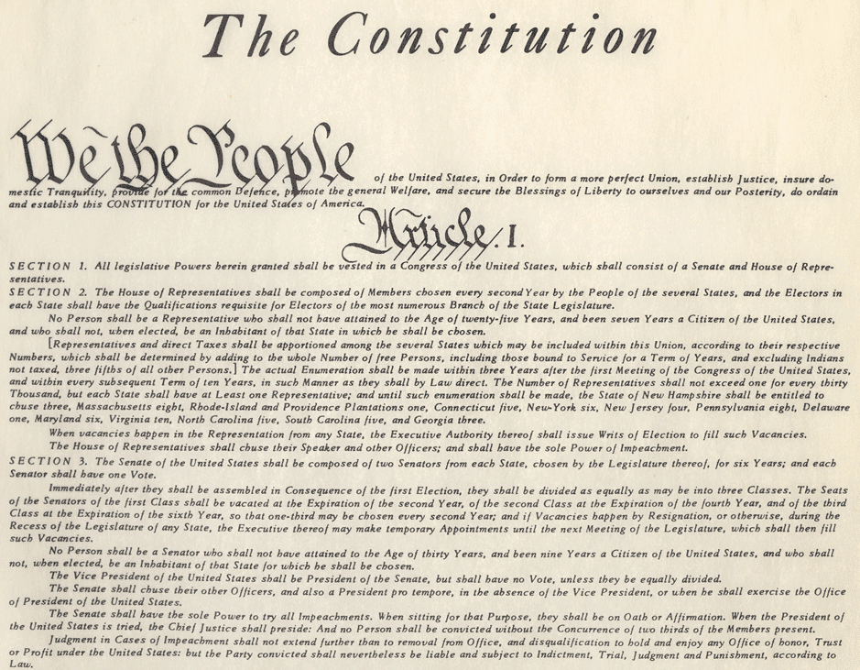
Organization of the Constitution
Preamble
Article I – Legislative Branch
Article II – Executive Branch
Article III – Judicial Branch
Article IV – Relations among the States
Article V – Methods of Amendment
Article VI – National Supremacy
Article VII – Ratification

Slide 13
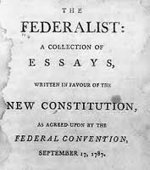
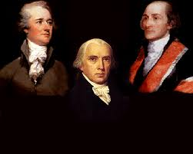
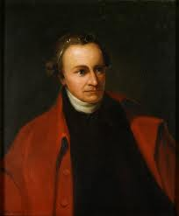
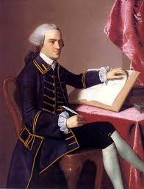
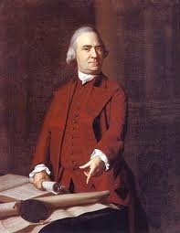
Ratification of the Constitution
Anti-federalists
Patrick Henry
John Hancock
Samuel Adams
Federalists vs.
John Jay
Alexander Hamilton
James Madison
Federalist Papers

Slide 14
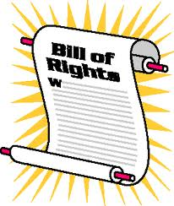
Amending the Constitution
The Bill of Rights, the first ten amendments, was added to the Constitution in order for the Anti-Federalists to support ratification.
Article V sets out the methods for formally amending the Constitution.
“Informally amending” the Constitution takes place through basic legislation, executive actions, court decisions, party practices and customs.
There are currently 27 amendments to the U.S. Constitution.

Slide 15
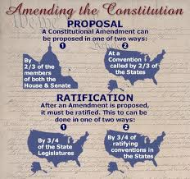
Four methods of amending the Constitution

